Slide 1
Canadian Bioinformatics Workshops
www.bioinformatics.ca

Slide 2
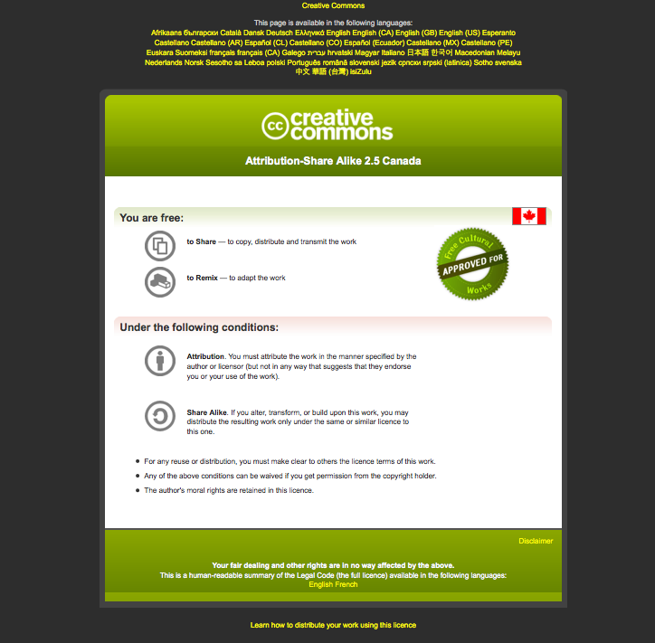
Module #: Title of Module
2

Slide 3
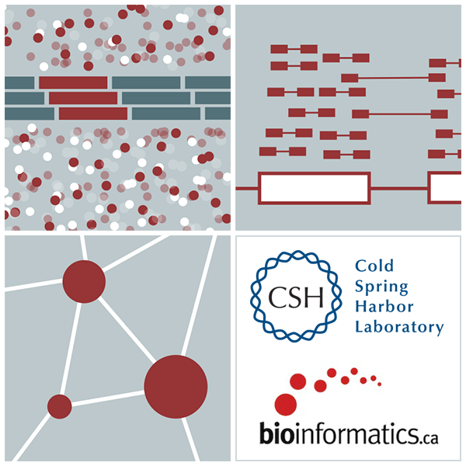


Module 15 De Novo subnetwork clustering analysis - Reactome
Robin Haw
High-Throughput Biology: From Sequence to Networks
March 20-26, 2017

Slide 4
Learning Objectives of Module
Be able to perform pathway and network-based data analysis using ReactomeFIViz app

Slide 5
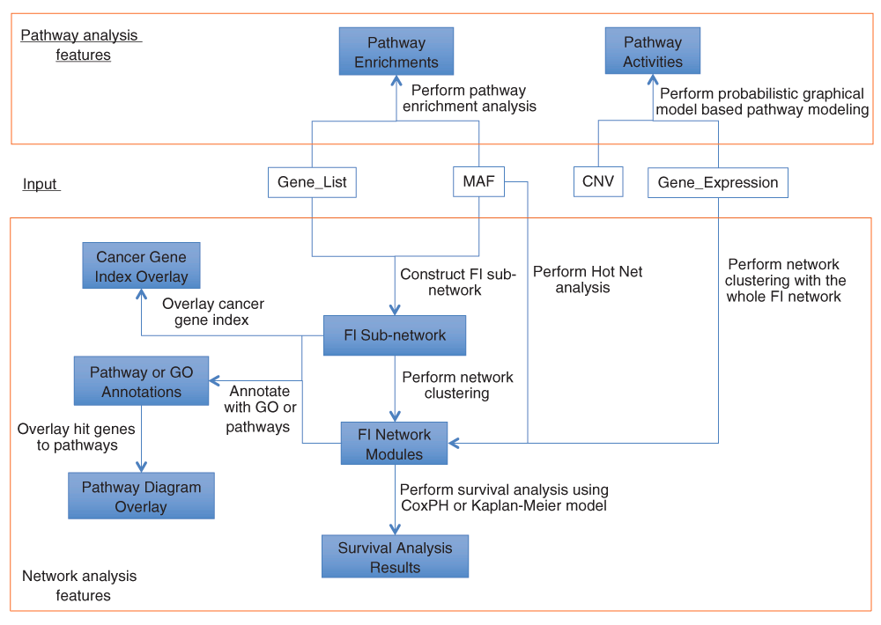

Major Features in ReactomeFIViz
Wu G, Dawson E, Duong A et al. 2014 [v2; ref status: indexed, http://f1000r.es/4cf] F1000Research 2014, 3:146 (doi: 10.12688/f1000research.4431.2)

Slide 6
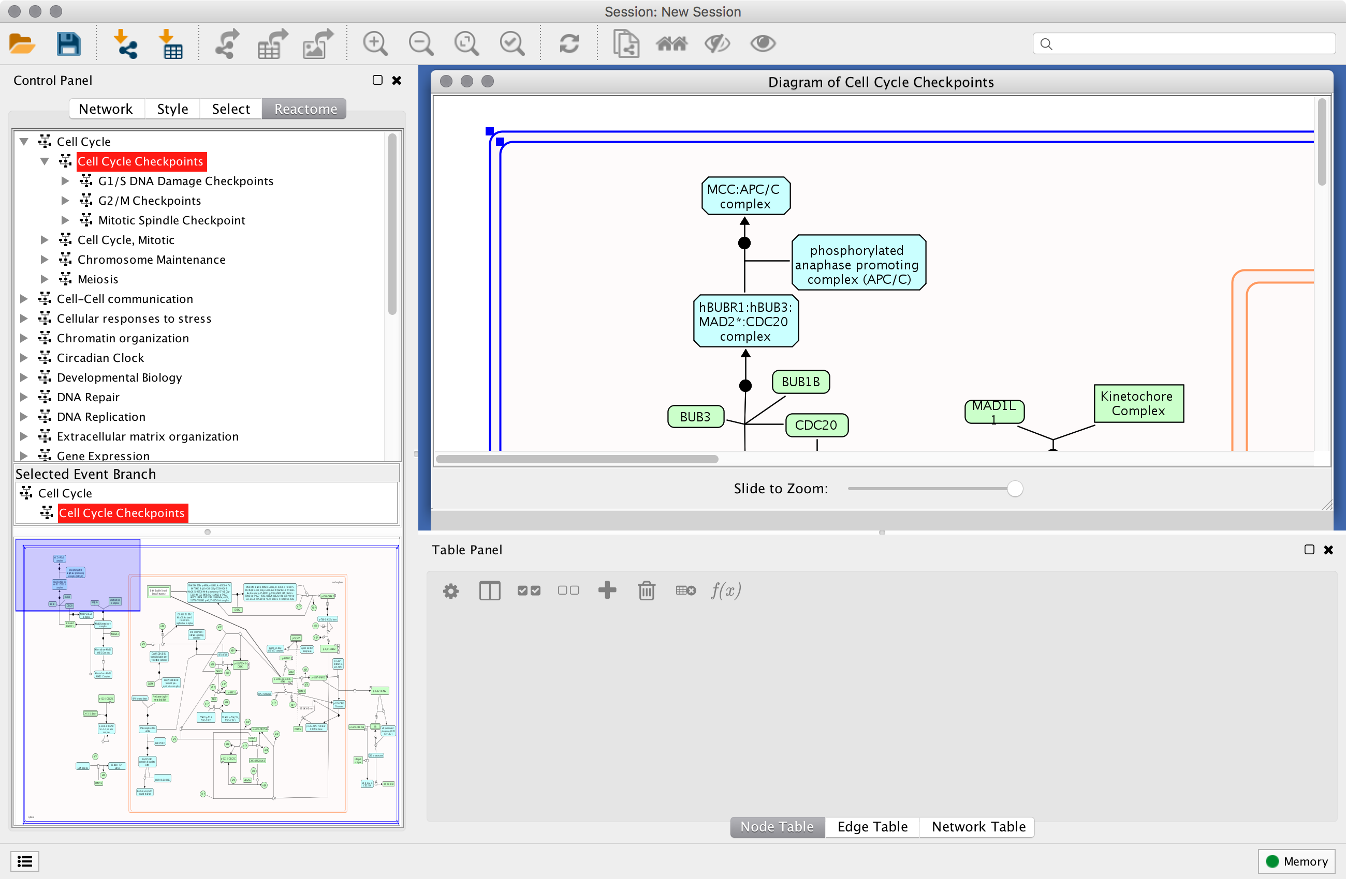
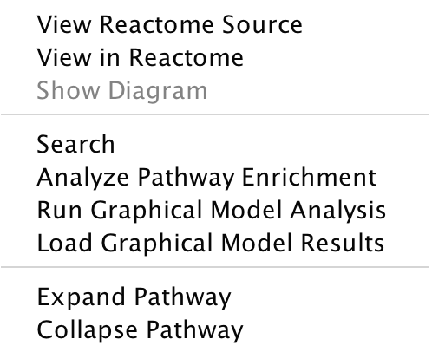
A1) Reactome Pathway Enrichment Analysis
Notes:
Users can navigate through the Reactome event hierarchy and display pathways and reactions within the Cytoscape application.
This can be a starting point for data analysis and visualisation through the ReactomeFIViz app or other Cytoscape apps.

Slide 7
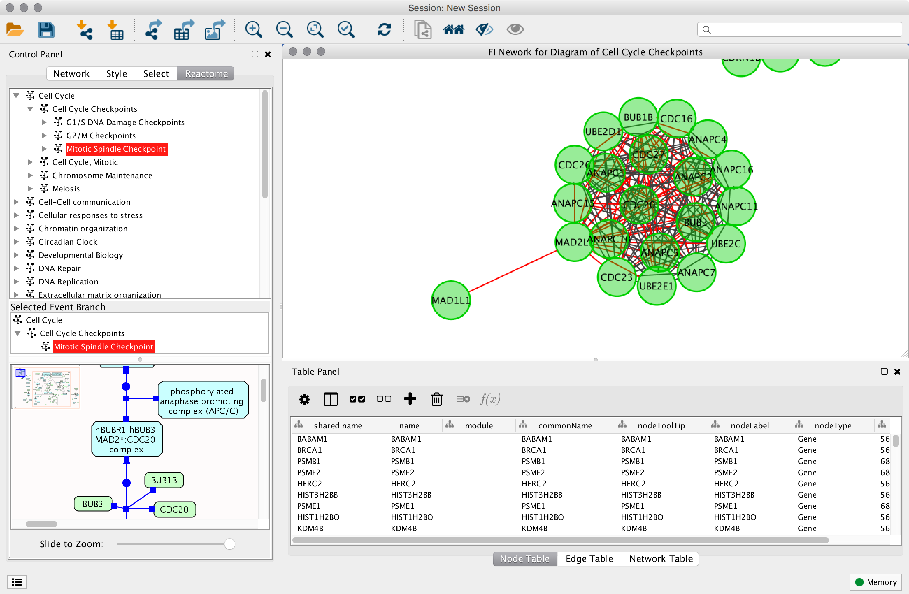
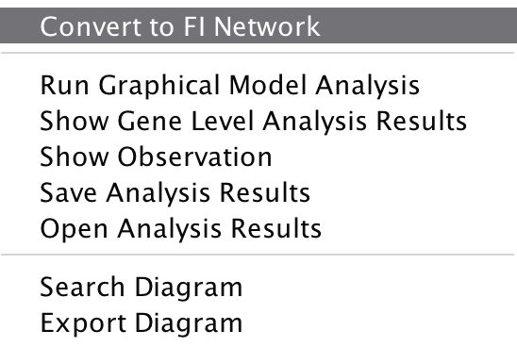
Displaying Reactome Pathways in the FI Network View
Notes:
Users can convert Reactome pathway into Reactome FI network.
And also toggle back to the Pathway view.

Slide 8
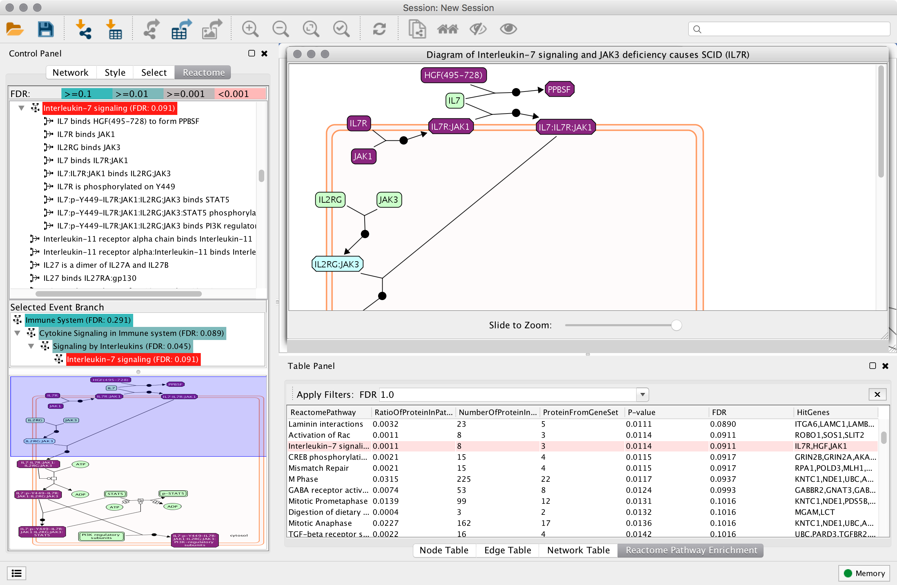
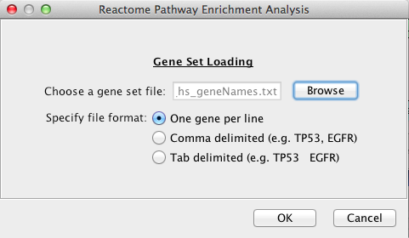
Pathway Enrichment Analysis
Notes:
Finally, users can perform pathway (or network) enrichment analysis and colourize pathway/network diagrams
Colourized diagram in the top panel with a list of significant events in the lower right panel.

Slide 9

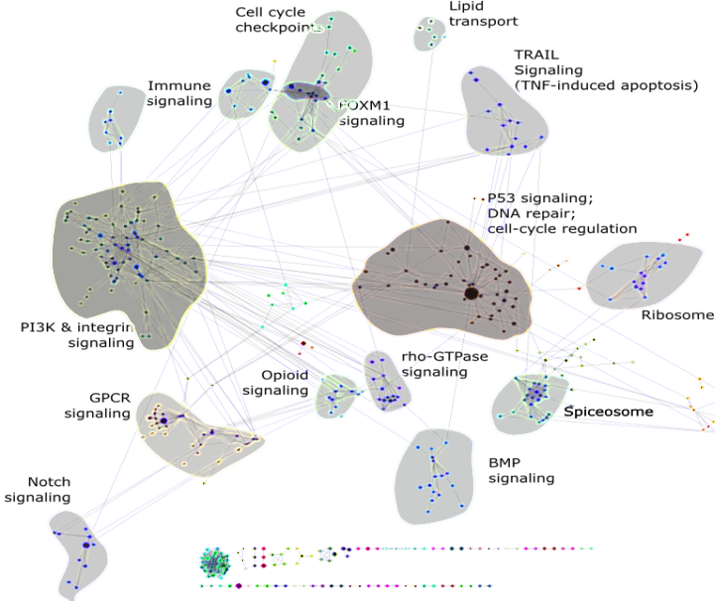
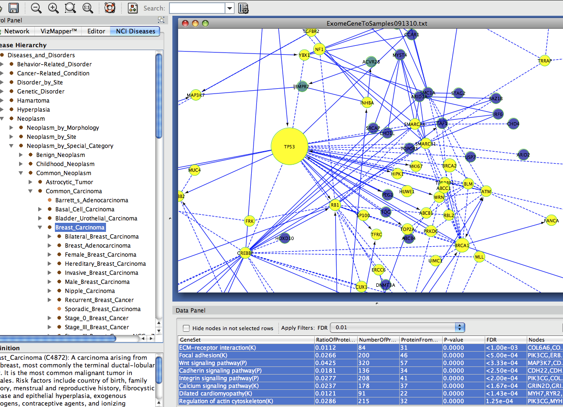
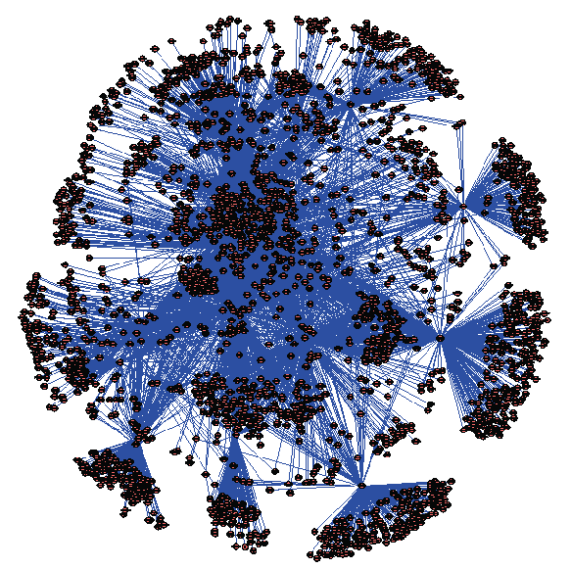
A2) De Novo Subnetwork Construction & Clustering
+
Machine Learning
Reactome Functional Interaction Network
(~12K proteins; ~328K interactions)
Curated
Pathway DBs
Uncurated
Interaction
Evidence
+
Project your data into Reactome FI Network
Extract and Cluster, and Annotate Altered Genes
Disease “modules” (10-30)
Cytoscape using ReactomeFIViz app
Notes:
This analysis approach is called De Novo Subnetwork Construction and Cluster.
You can apply a list of altered {genes,proteins,RNAs} to a much larger pre-constructed biological network.
Identify “topologically unlikely” configurations by filtering away unnecessary interactions.
Extract clusters of tightly connected gene interactions.
Annotate the clusters.

Slide 10
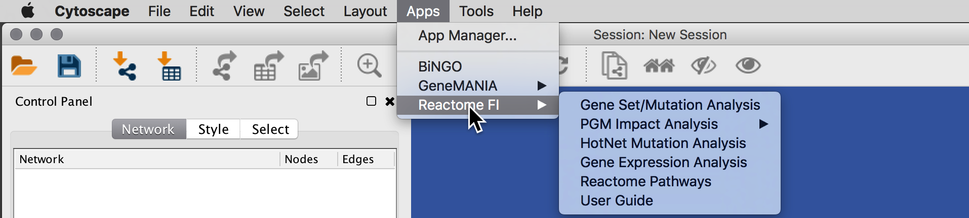
Upload your data
FI plug-in supports four file formats:
Simple gene set: one line per gene
Gene/sample number pair. Contains two required columns, gene and number of samples having gene mutated, and an optional third column listing sample names (delimited by semi-colon ;)
NCI MAF (mutation annotation file)
Sample Gene Expression data file

Slide 11
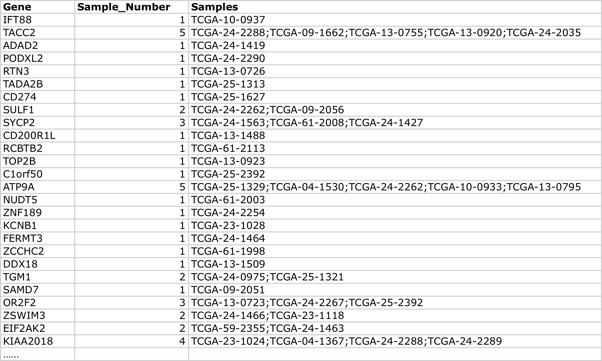
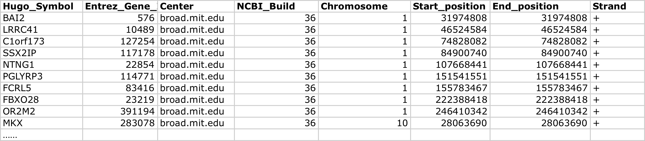
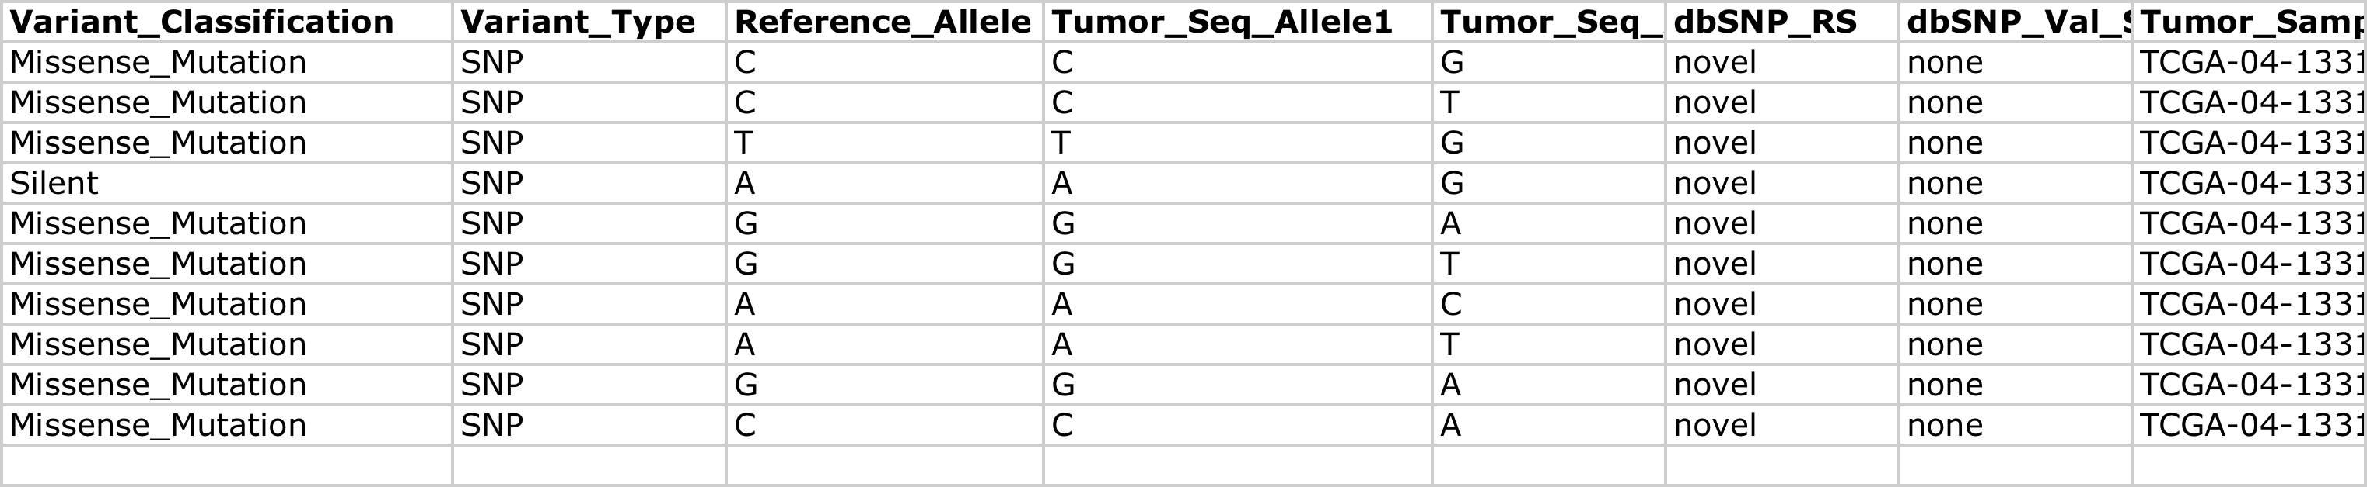
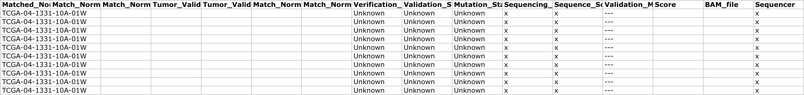
File Formats
Choose Plugins, Reactome FIs.
FI plug-in supports four file formats:
Microarray (array) data file
Simple Gene List
Gene/Sample Number Pairs
NCI MAF (mutation annotation file)
MSI2
PTPRT
PELO
SLC18A1
TACC2
FAM148B
PRC1
MSTN
ATP6V1G2
APOE
IMPA2
AGER
XPO5
MEST
RREB1
BAT1
WIPI1
CATSPERB
SSR1
VEGFA
Notes:
The current implementation of FI plug-in can recognize four file formats:
The first one is just a single list of genes. One line for one gene.
The second format is gene/sample pairs. The first column is a list of genes, the second is a list of numbers of samples having gene mutated, and the third optional column list actual sample names.
The third format is NCI mutation annotation file. The are multiple columns in this file. The plug-in can pick-up mutated genes, and samples for mutated genes from this format.
The fourth format is Microarray (array) data file. An array data file should be a tab-delimited text file with table headers. The first column should be gene names. All other columns should be expression values in different samples. The data set in the file should be pre-normalized.

Slide 12
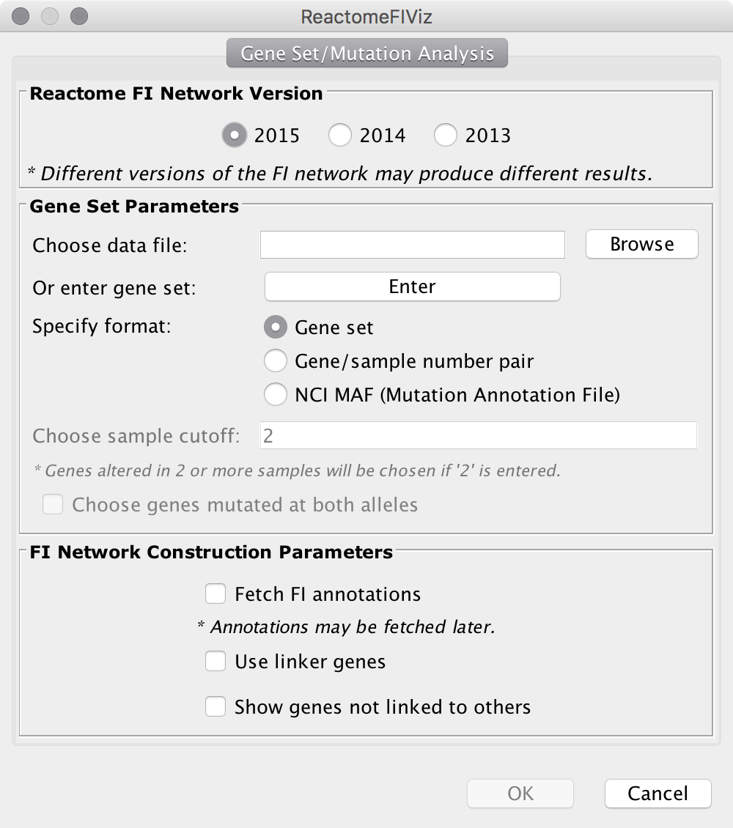
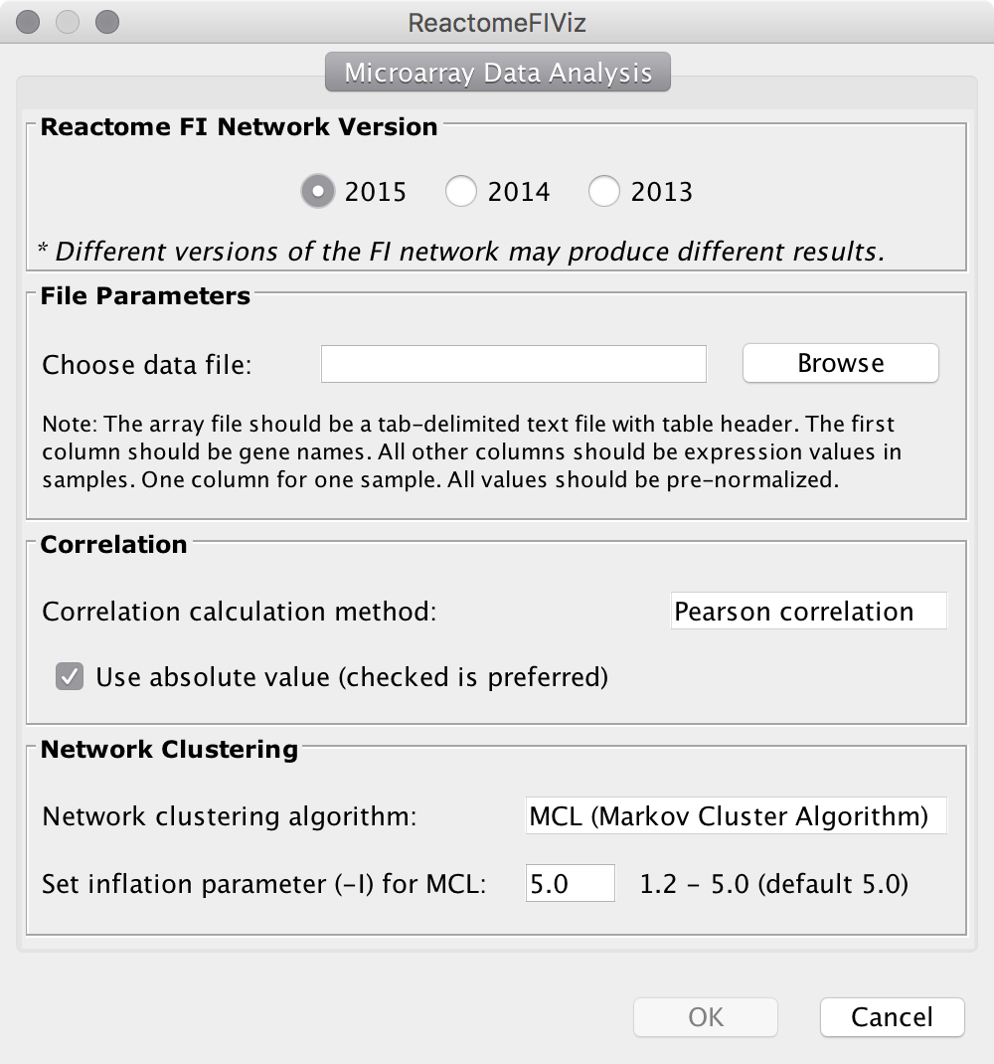
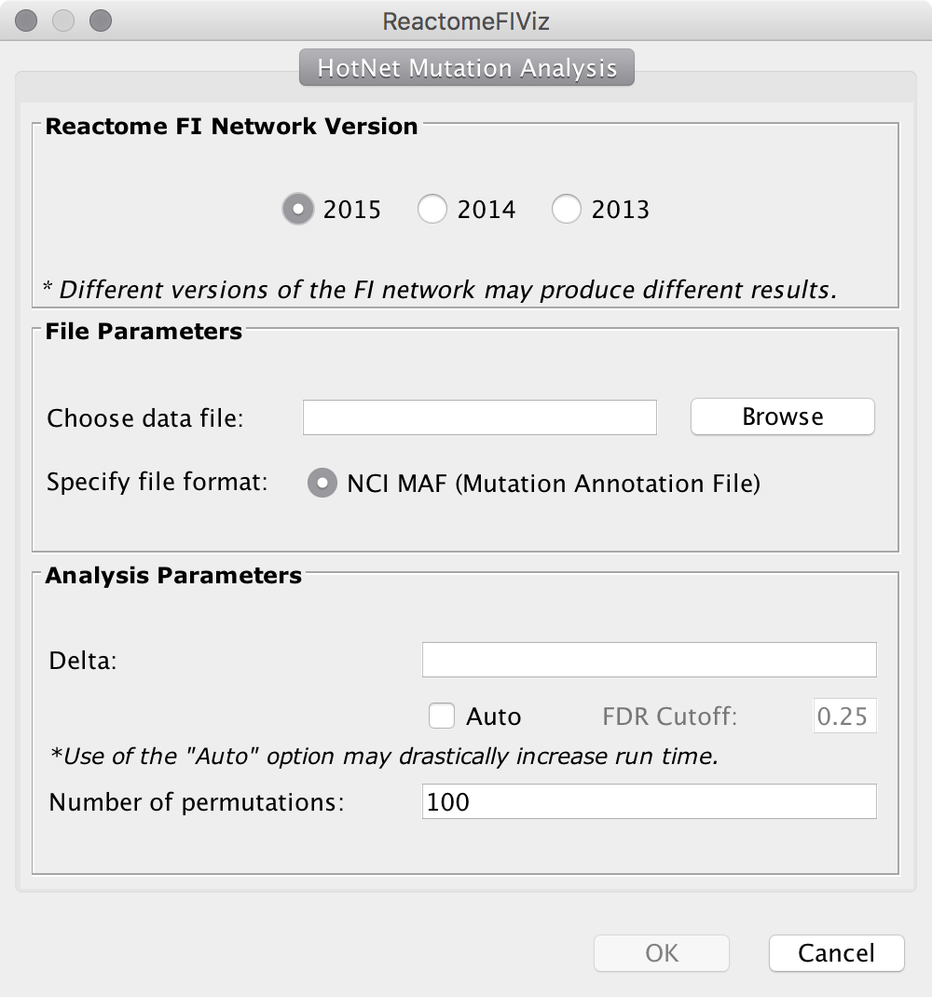
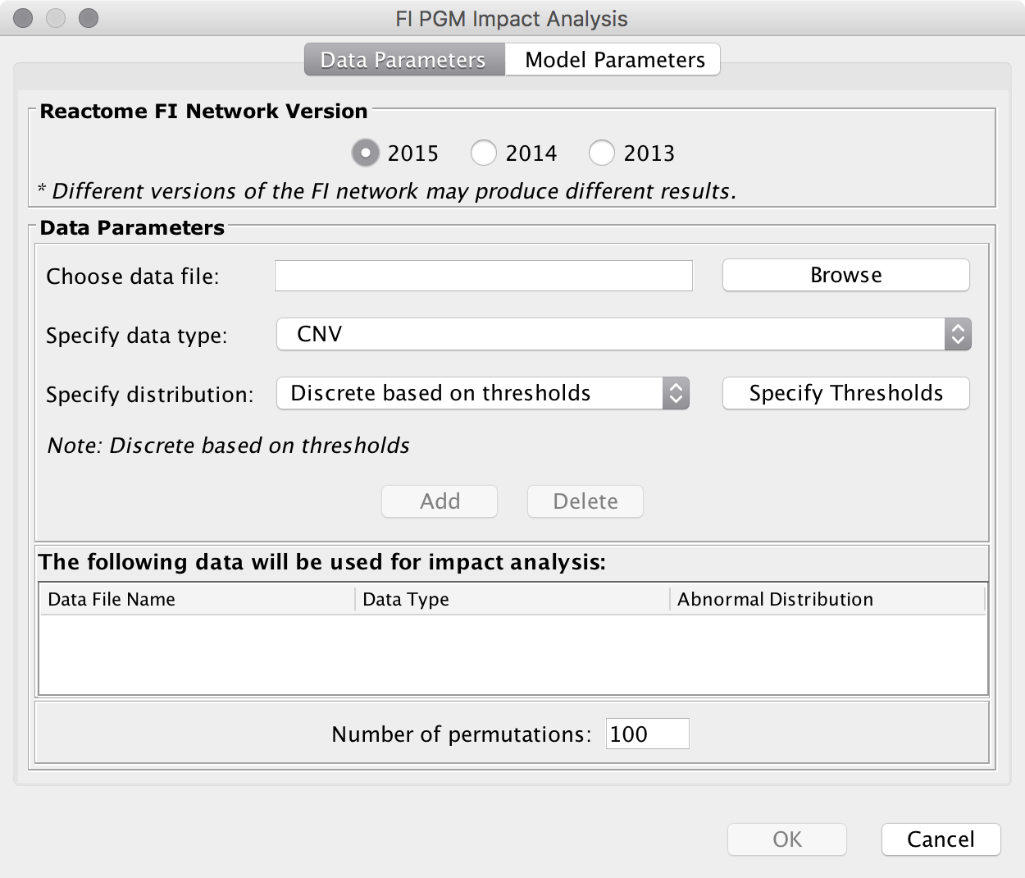
Upload your data
Gene Set/Mutation Analysis
HotNet Mutational Analysis
Microarray Data Analysis
Probabilistic Graph Models (PGM)

Slide 13
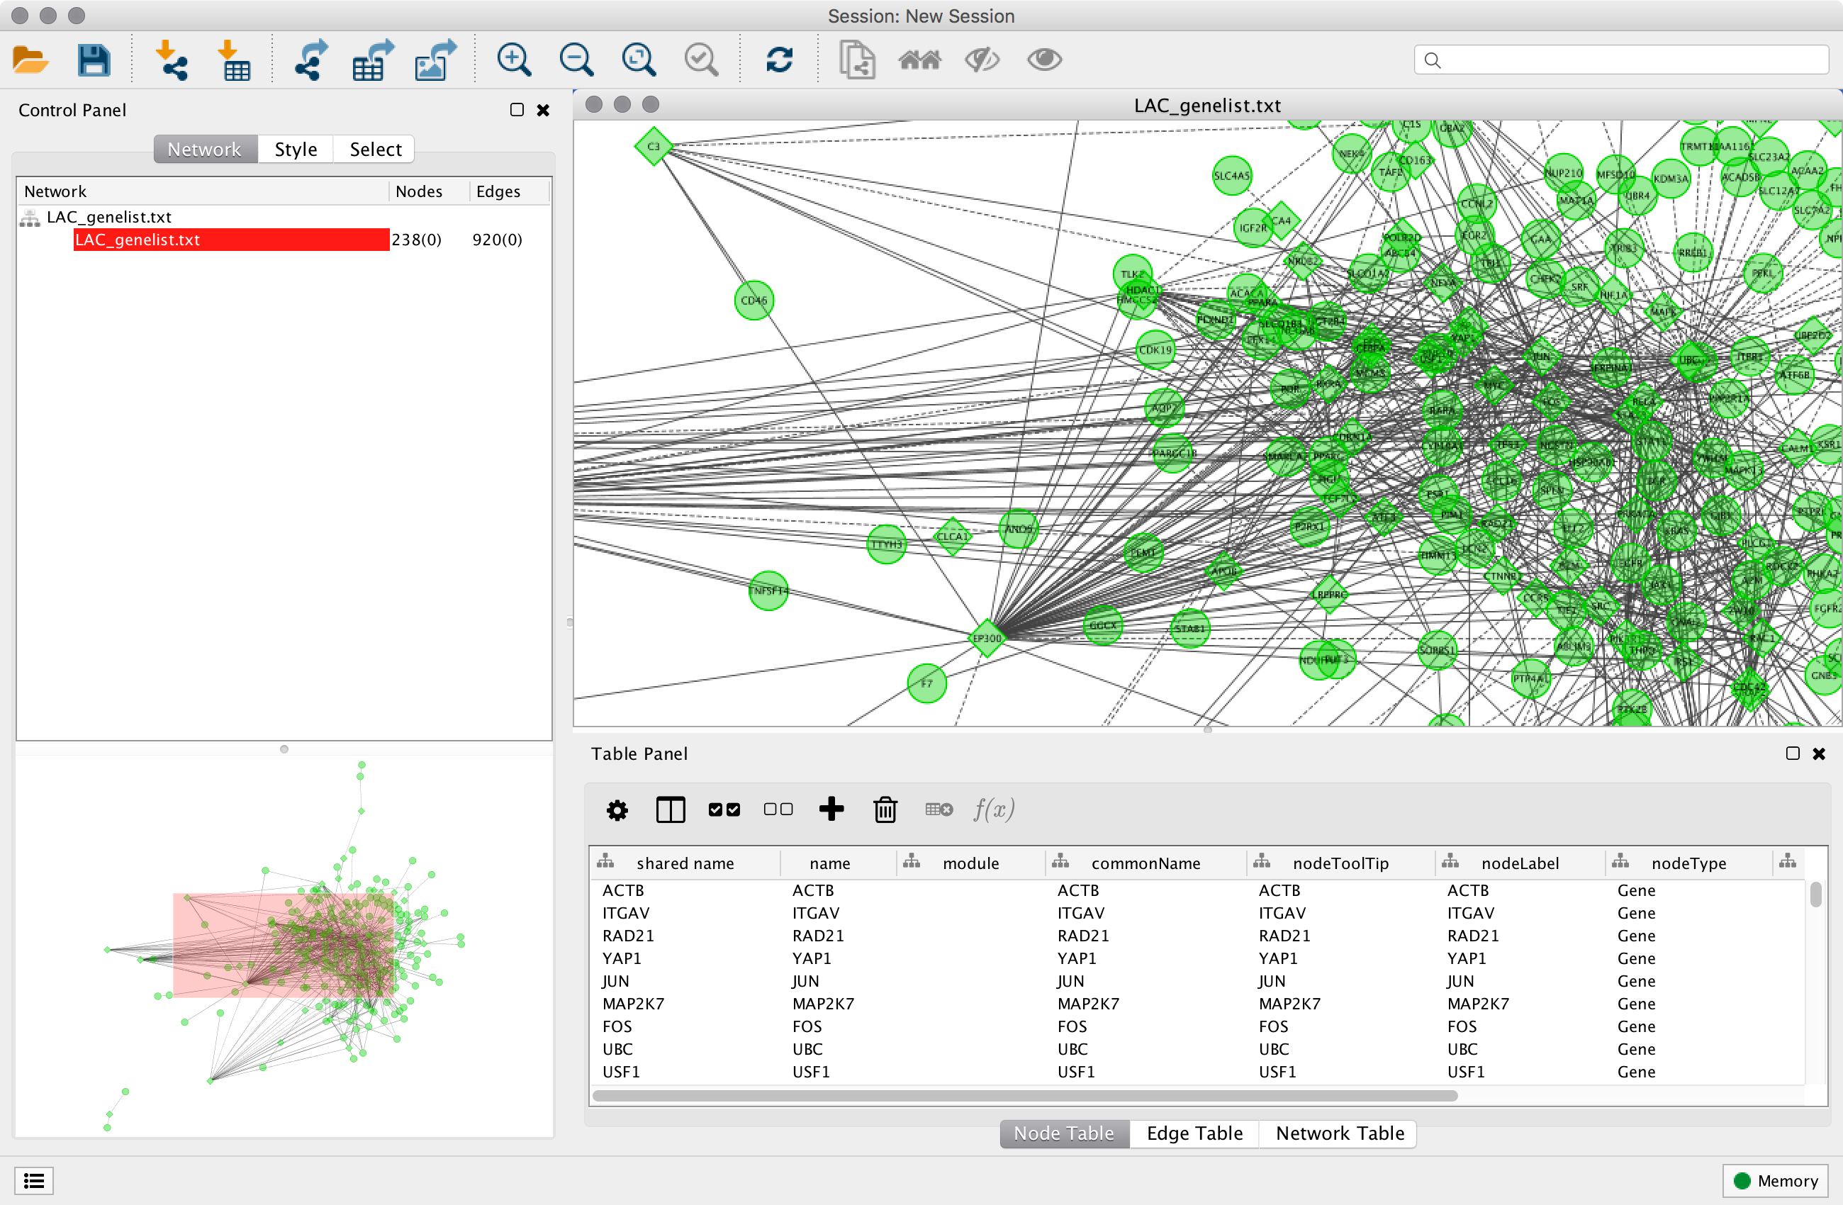
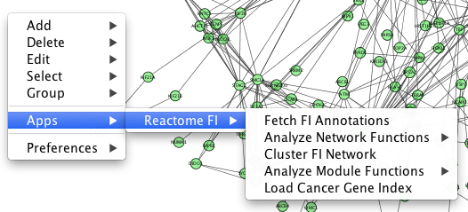

FI Results Display
The main features of the plug-in are invoked from a popup menu, which can be displayed by right clicking a white space, a node or edge in the the network view panel.
Constructed network is displayed in the Network View panel using an FI specific visual style
Notes:
The constructed network is displayed in the Network View panel using an FI specific visual style.
The table panel will display the node, edge, and analysis parameters as you perform the difference steps of the FI analysis.

Slide 14
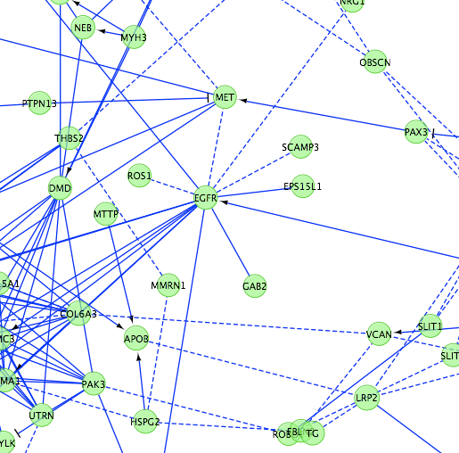
FI Annotations
Provides detailed information on selected FIs.
Three edge attributes are created:
FI Annotation.
FI Direction.
FI Score (for predicted FI).
Edges display direction attribute values.
--> for activating/catalyzing.
--| for inhibition.
solid line for complexes or inputs.
--- for predicted FIs.
The main features of the plug-in are invoked from a popup menu, which can be displayed by right clicking a node or edge in the the network view panel.

Slide 15
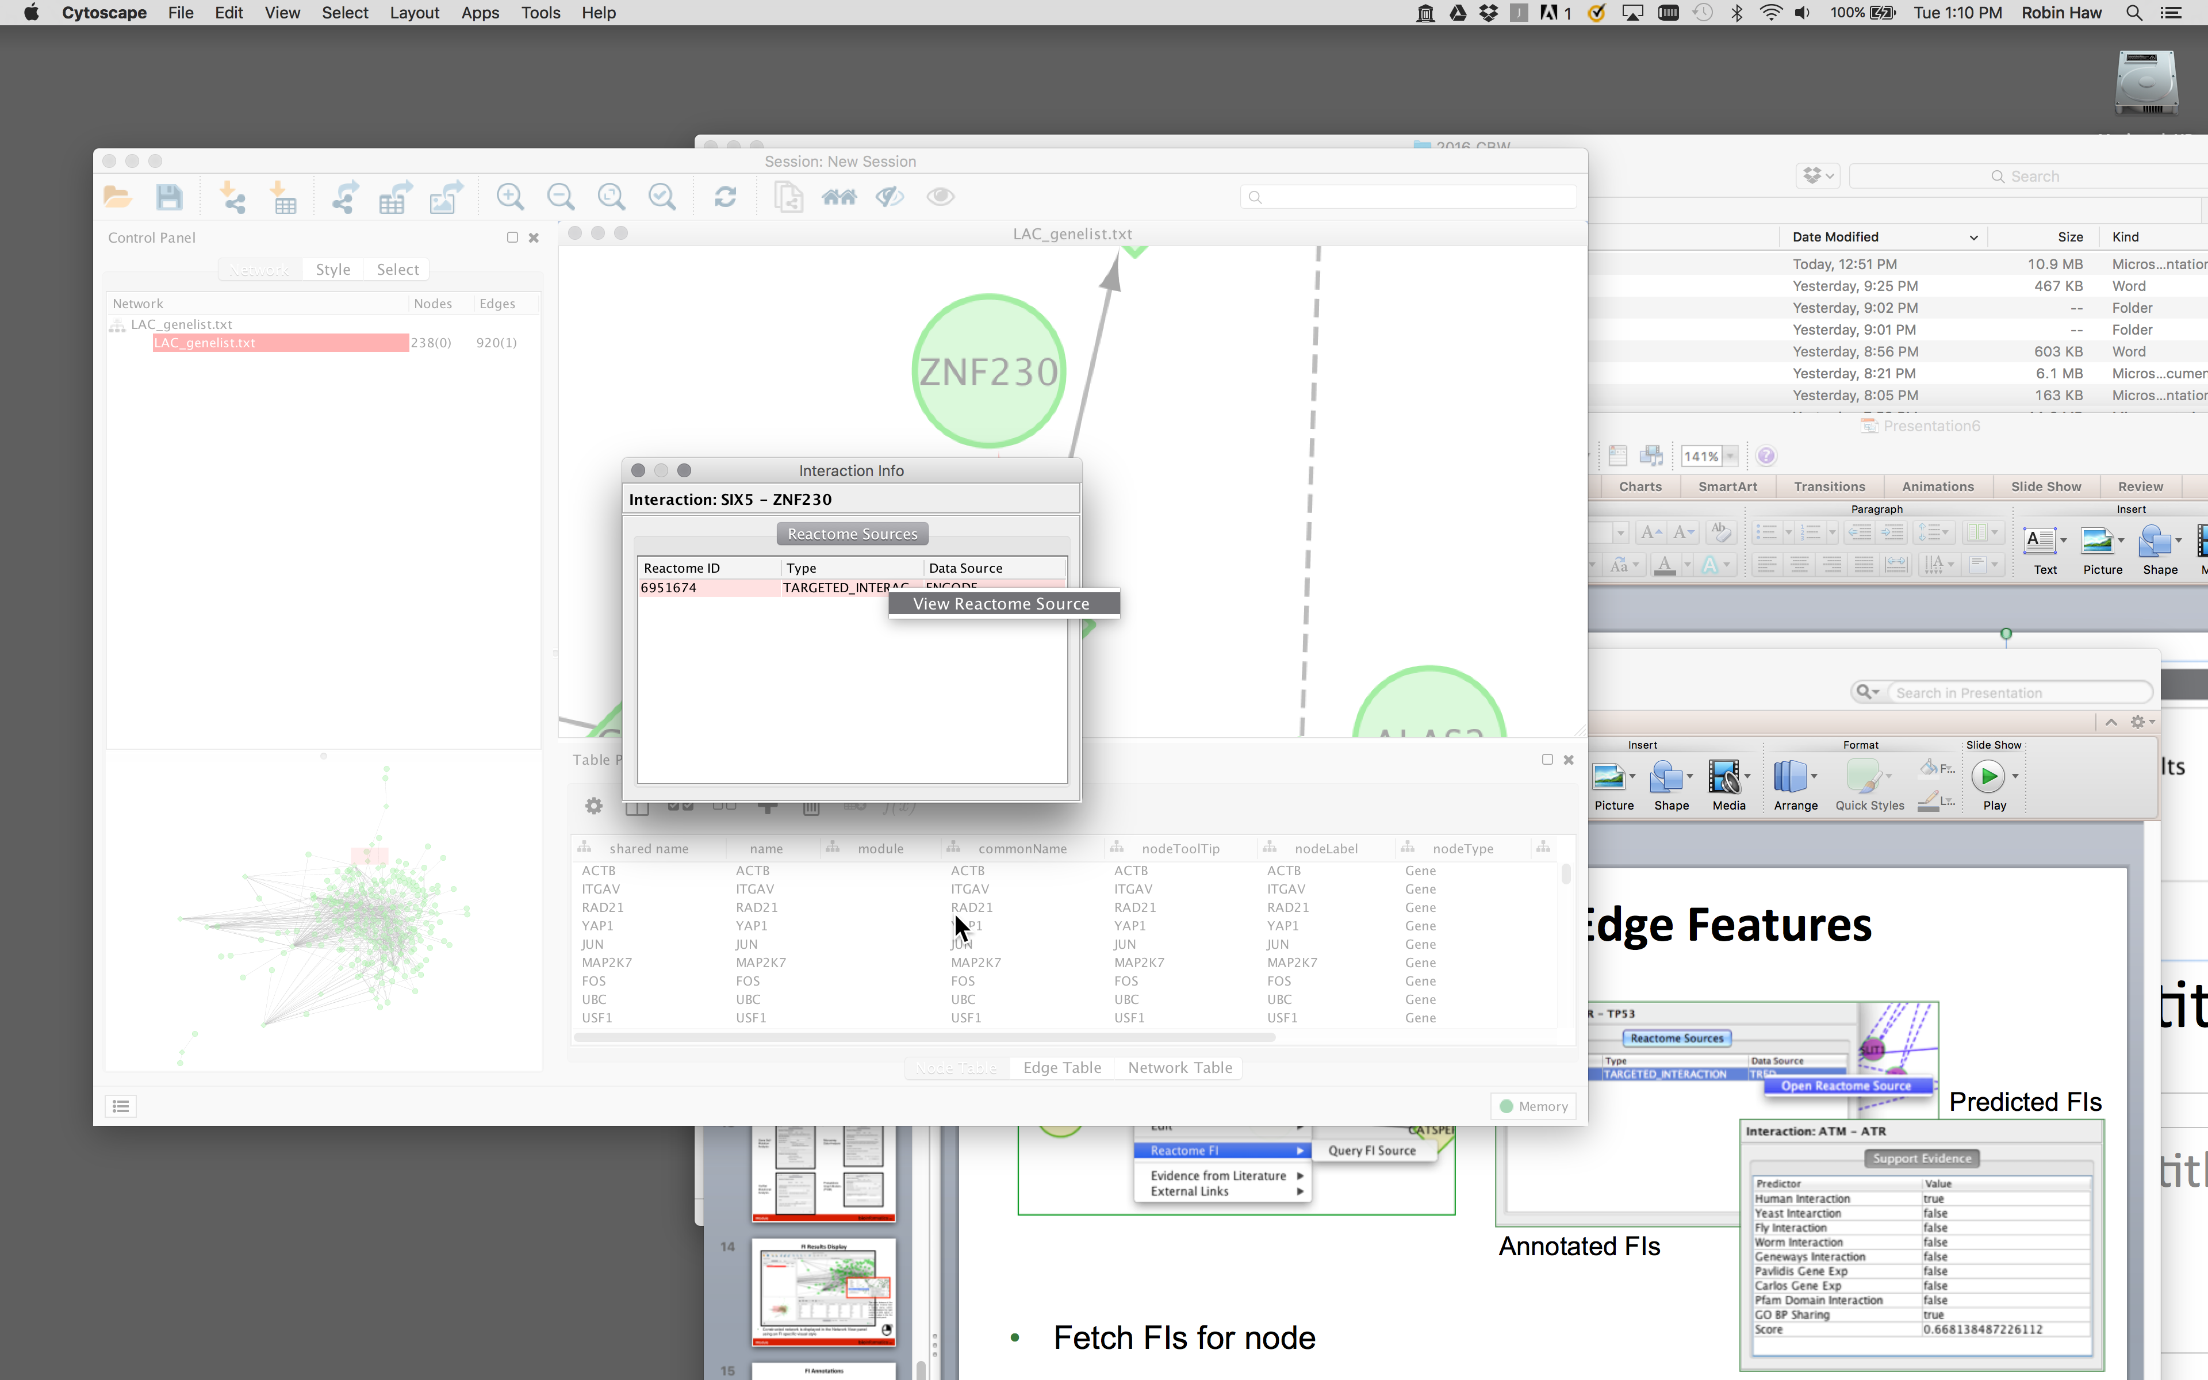
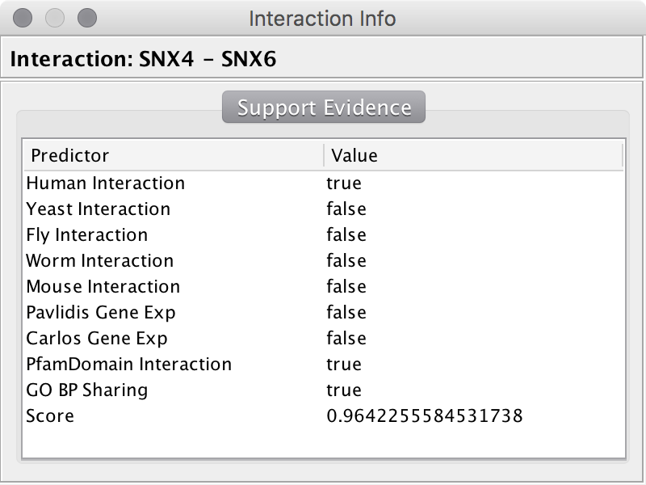
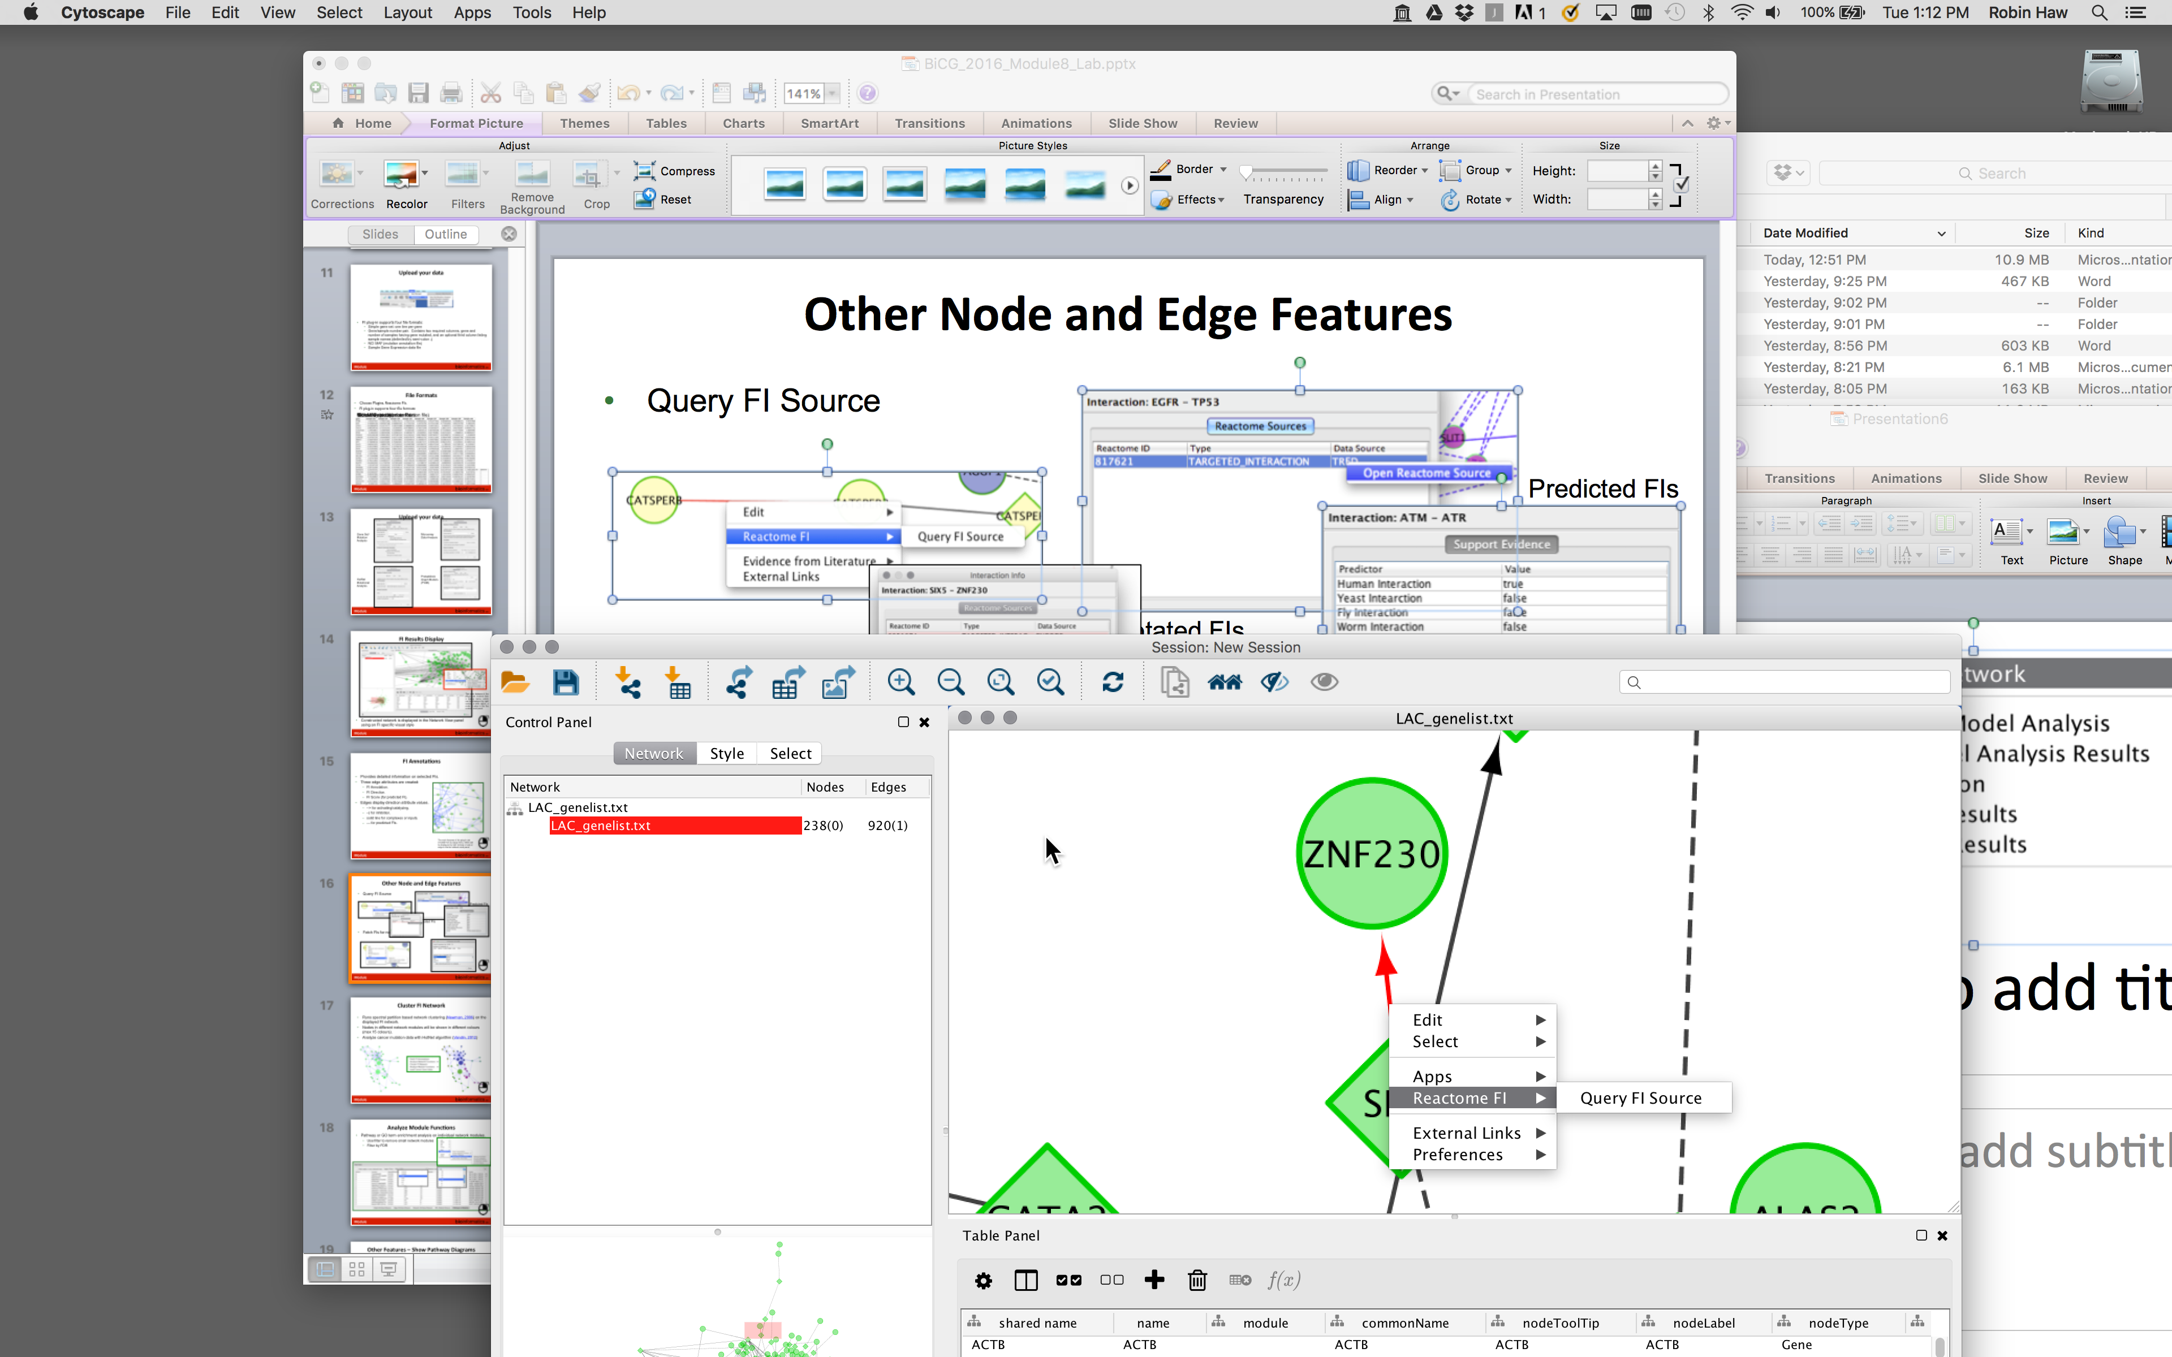
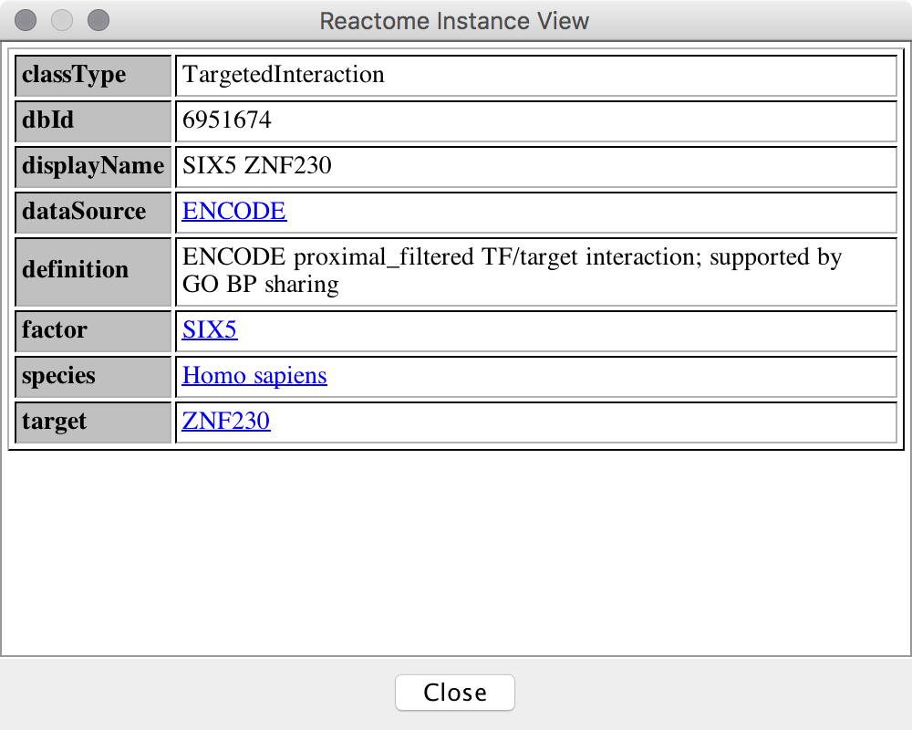
Query FI Source
Annotated FIs
Predicted FIs
Notes:
You can query the FI Source to view the source data used to derive the FI.
With Annotated FIs, you can view the source database, experiment type, publication, when it is available.
With the Predicted FIs, you will view a table which shows the dataset contained the interaction, and an FI score to indicate our level of confidence in the interaction occurring in the cell.

Slide 16
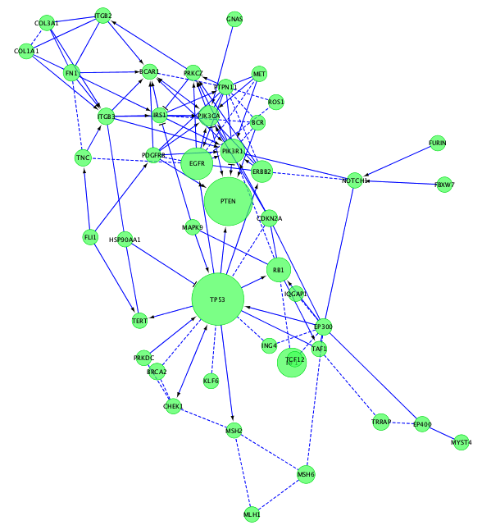
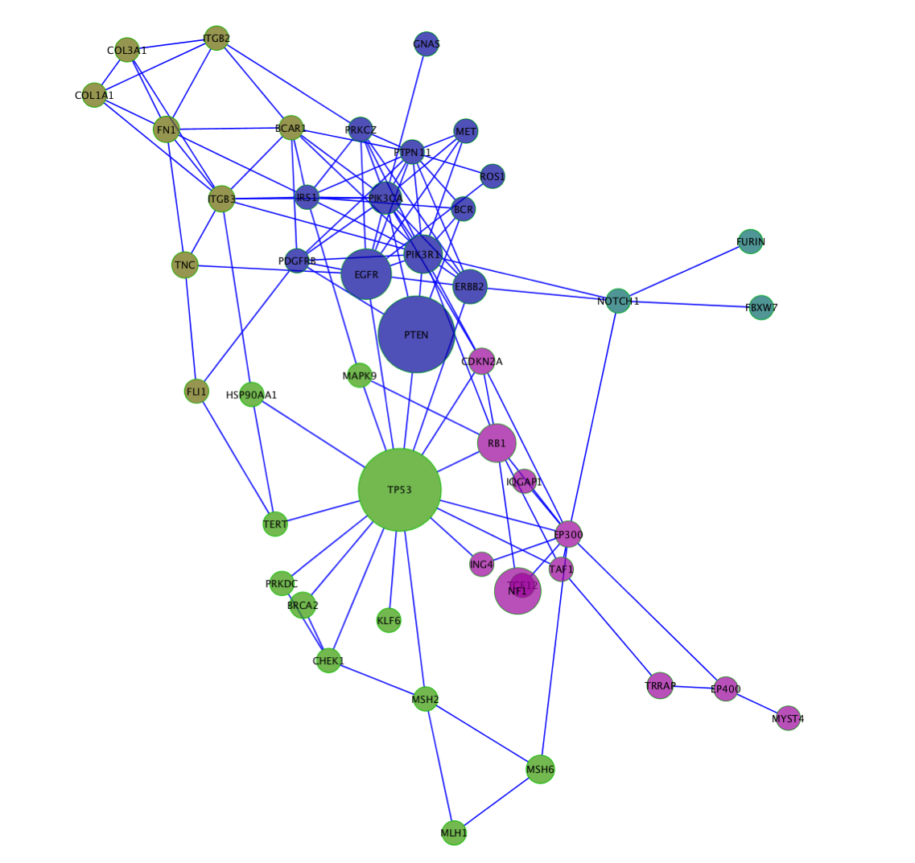
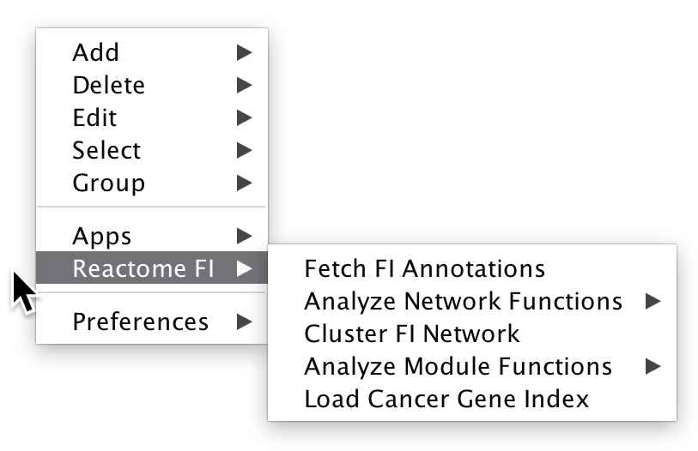
Cluster FI Network
Runs spectral partition based network clustering (Newman, 2006) on the displayed FI network.
Nodes in different network modules will be shown in different colours (max 15 colours).
Analyze cancer mutation data with HotNet algorithm (Vandin, 2012)
Notes:
The next step in the analysis is to extract clusters of these unlikely configurations.
GN – is typically used for analysis of most datasets.
MCL – used for analysis of microarray gene expression datasets.
HotNet – for the analysis of cancer datasets where you would like to avoid ascertainment bias on unusually well-annotated gene.
The typical output of clustering is demonstrated in this hypothetical subnetwork.

Slide 17
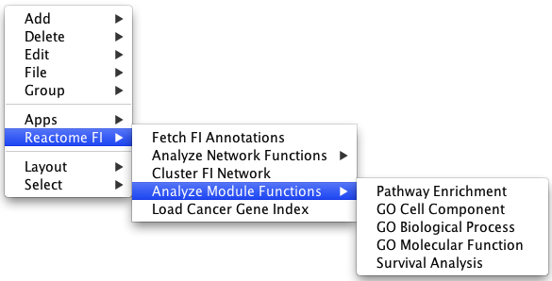
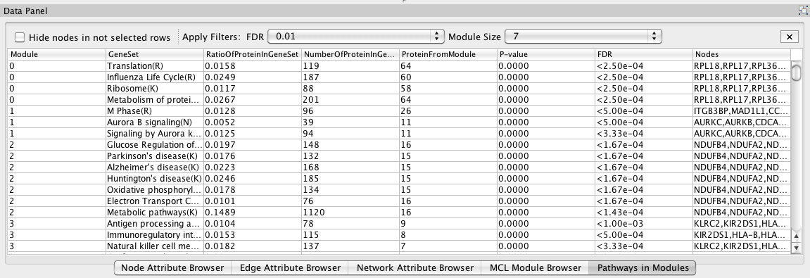
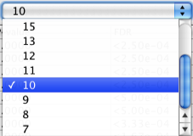
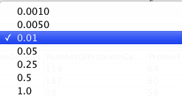
Analyze Module Functions
Pathway or GO term enrichment analysis on individual network modules.
Use filter to remove small network modules
Filter by FDR
Notes:
Once you have identified the network modules, the next step of the analysis is lable those clusters with pathway or GO terms.

Slide 18
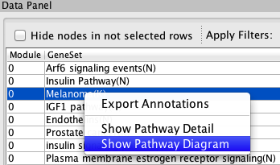
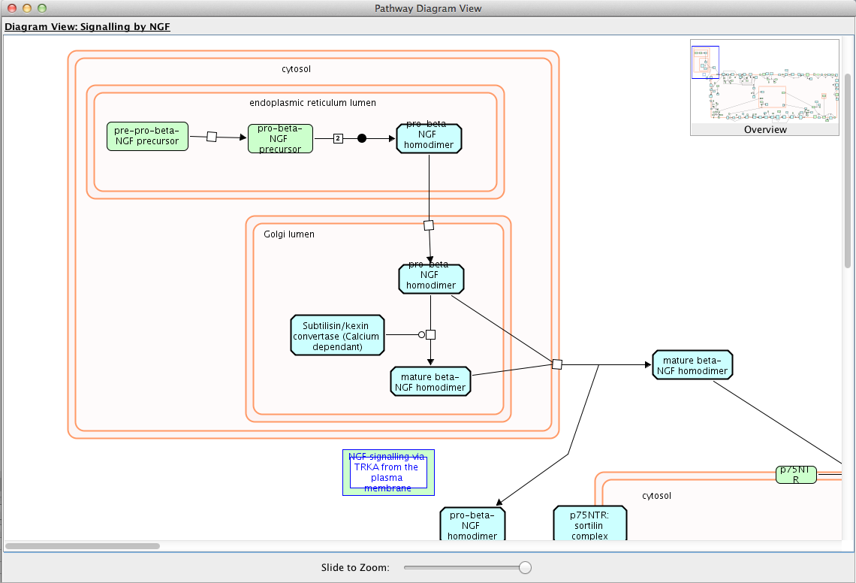
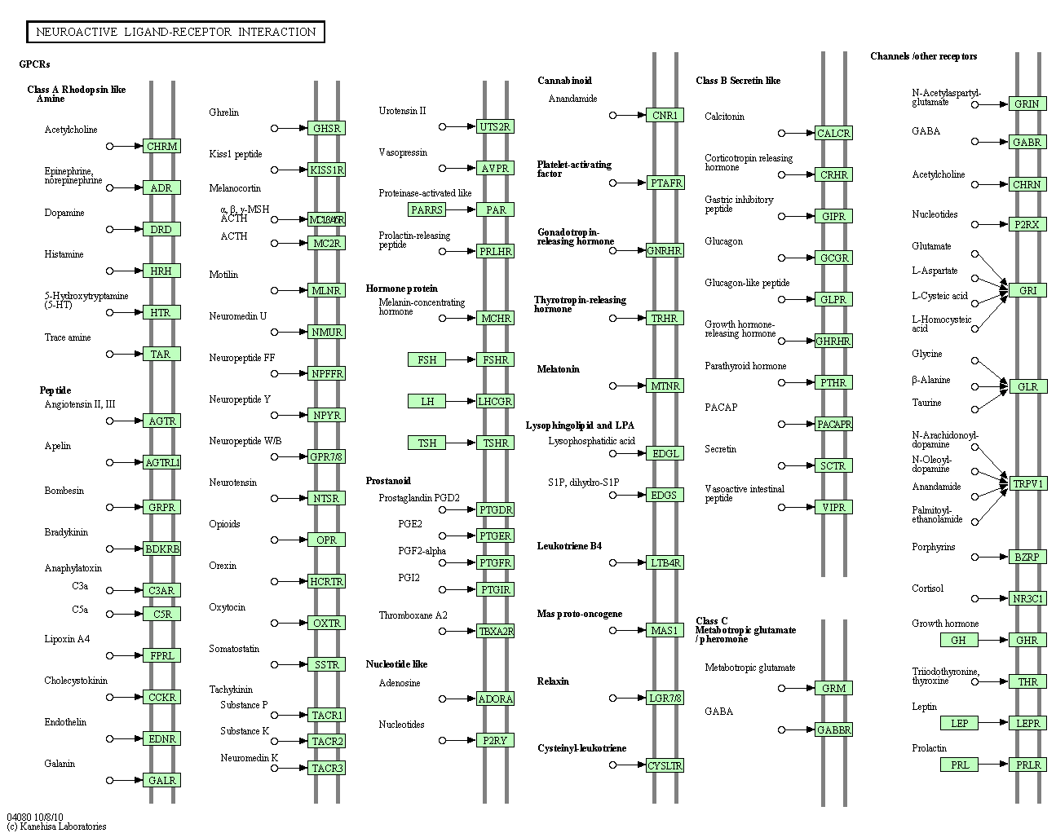
Other Features – Show Pathway Diagrams
Select a pathway in "Pathways in Network/Modules" tabs, right click, select "Show Pathway Diagram”

Slide 19
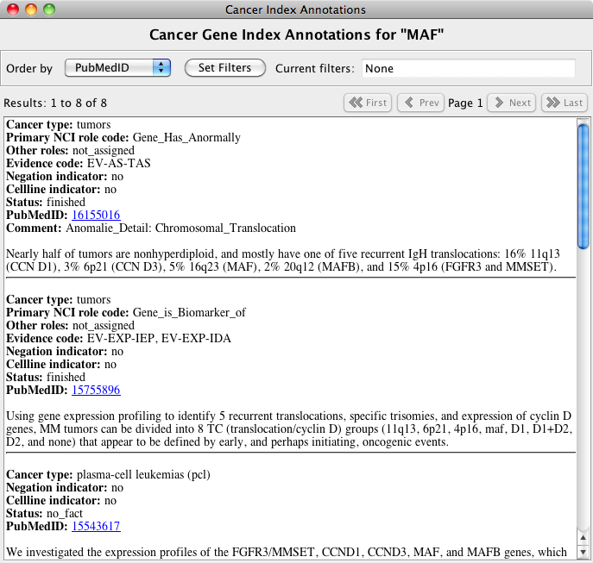
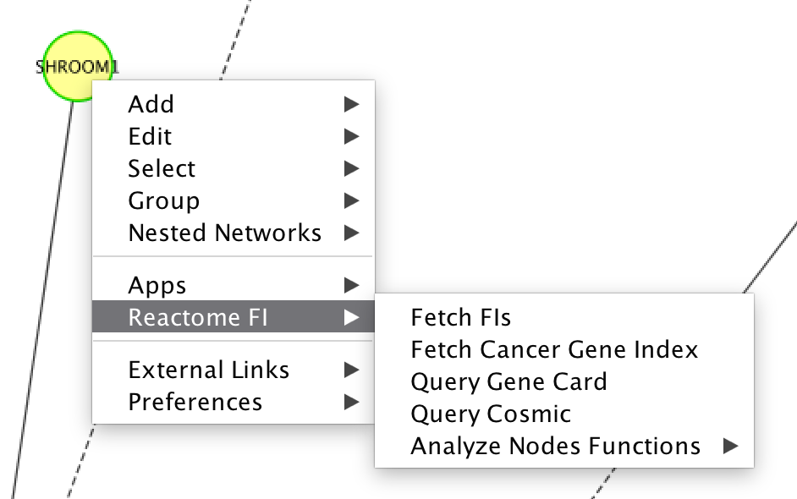
Other Features – NCI Cancer Gene Index
View detailed annotations for the selected gene or protein.
Annotations are sortable by PubMed ID, Cancer type, status, and other criteria.
Notes:
Some of the other features include the display of annotations from the NCI Cancer Gene Index for a selected node.
Annotations are sortable by PubMed ID, Cancer type, status, and other criteria.

Slide 20
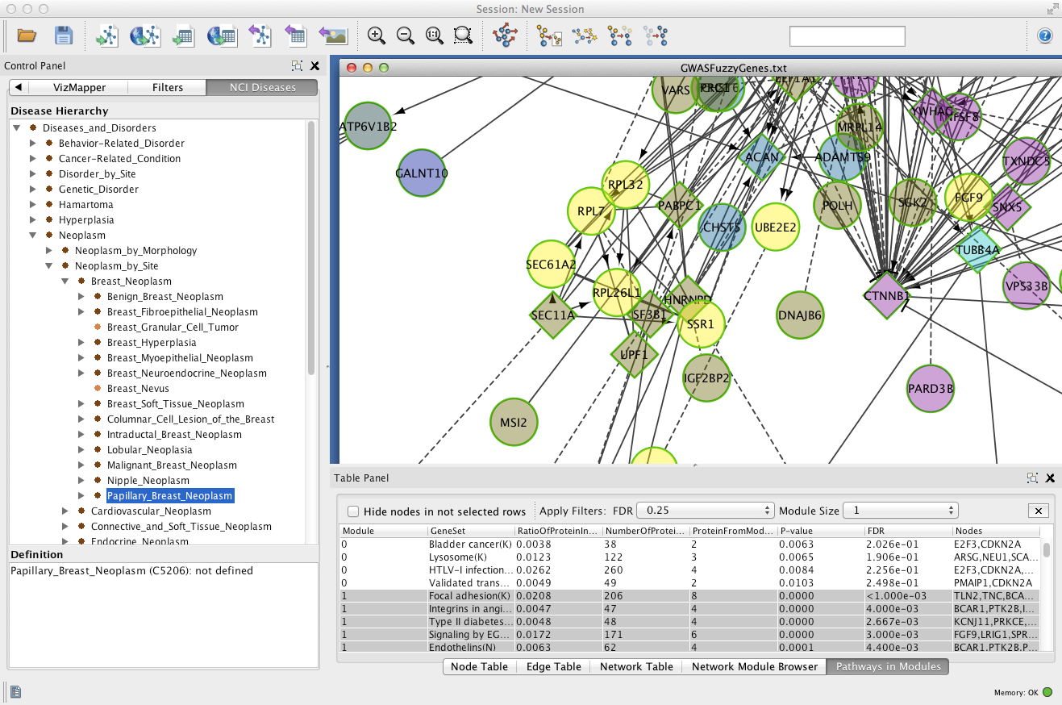
Other Features – Overlay Cancer Gene Index
Load the NCI disease terms hierarchy in the left panel.
Select a disease term in the tree to select all nodes that have this annotation or one of its sub-terms.
Notes:
Alternatively, you might want to highlight all nodes with the network that have a particular annotation from the NCI Cancer Gene Index.
Load the NCI disease terms hierarchy and select a disease term in the tree to select all nodes that have this annotation or one of its sub-terms.

Slide 21
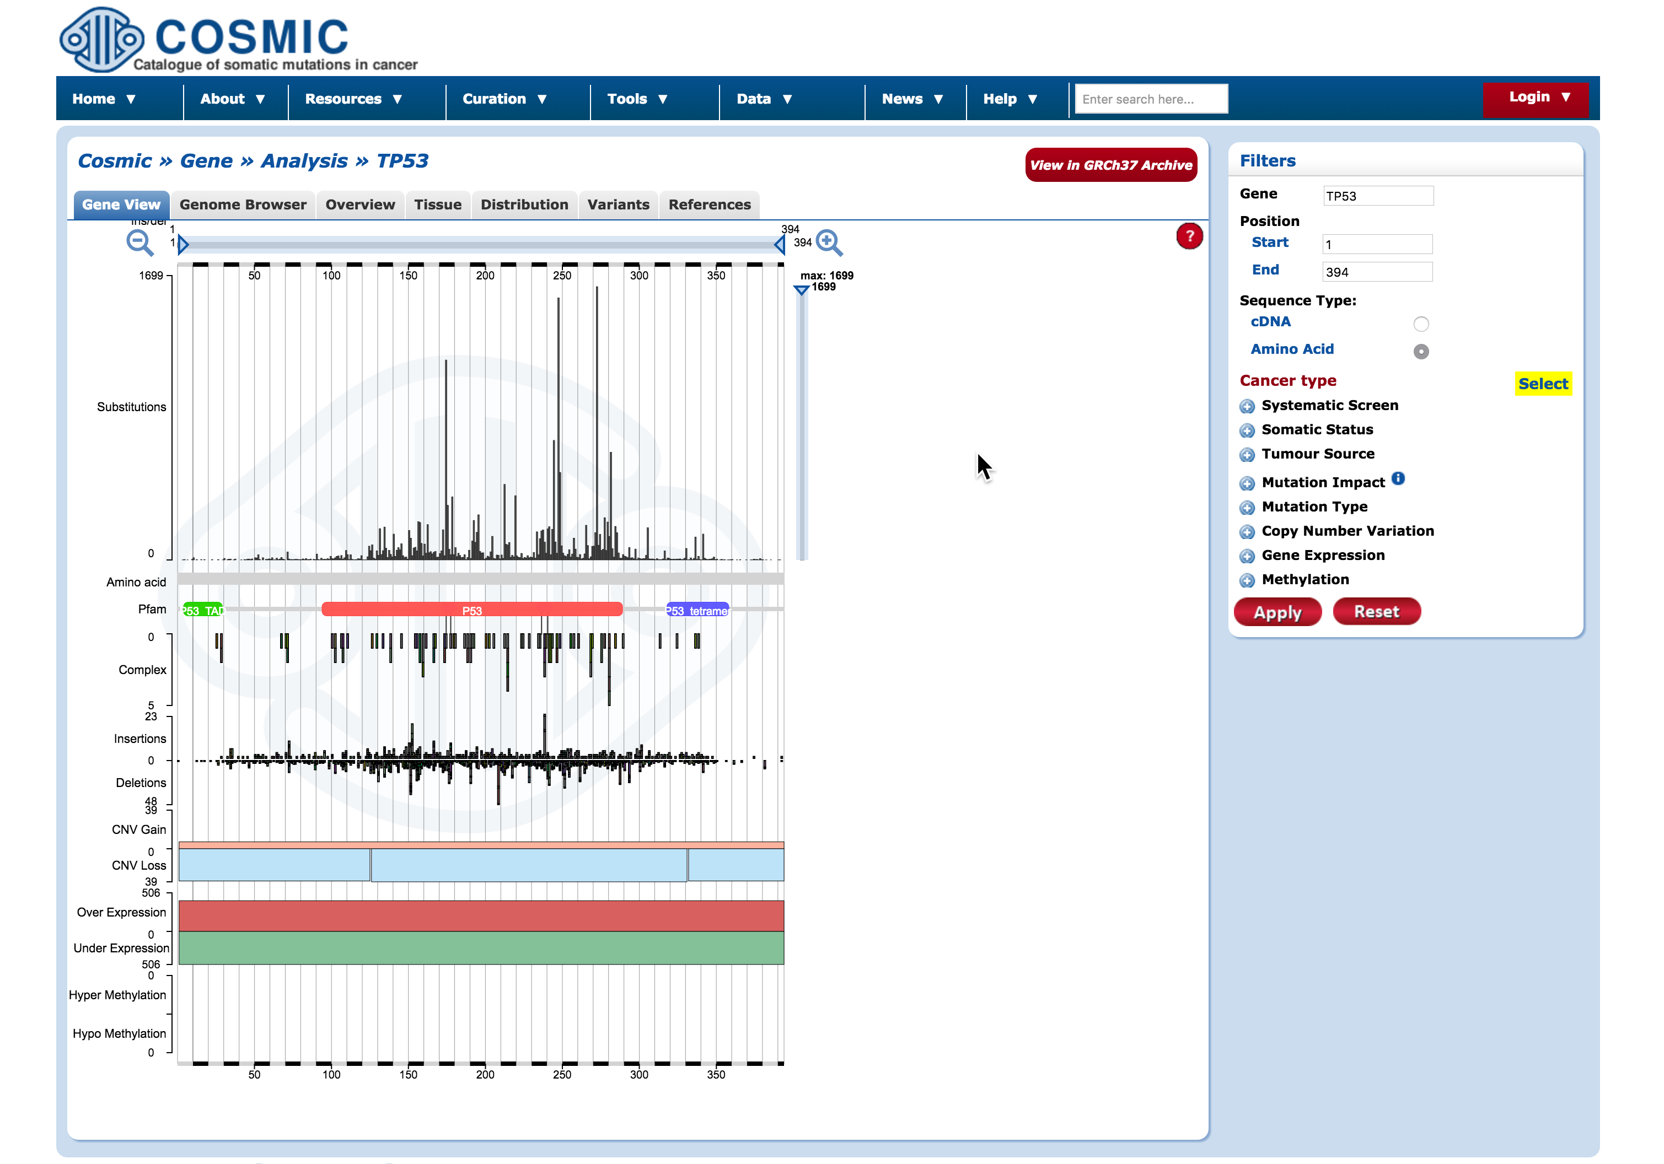
Other Features – COSMIC
View detailed variant annotations for the selected gene or protein from COSMIC database.
Notes:
You can also display annotations from COSMIC database for a selected node.

Slide 22
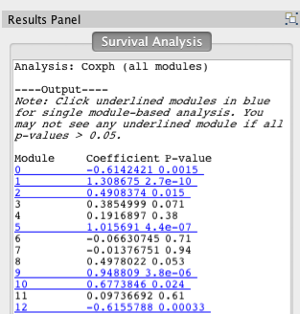
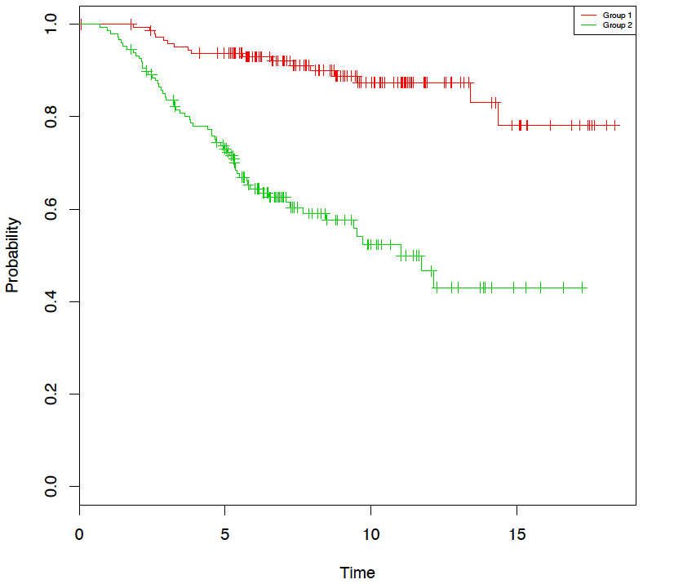
Module Based Survival Analysis
Discover Prognostic Signatures in Disease Module Datasets.
Based on a server-side R script that runs either CoxPH or Kaplan-Meyer survival analysis.
Requires appropriate clinical data file.
Notes:
One final step of the ReactomeFIViz app is to integrate in clinical data to try to identify a prognostic signatures in disease module datasets.
Two servers side R- scripts run wither cox proportional hazard or kaplan-meyer survival analysis.

Slide 23
Demo & Lab

